Slide 1
CSCE 623 In Class Day 03
HW1 Preview

Slide 2
HW1 Preview
Background/Motivation
Goals
Dataset Overview
Assignment Overview

Slide 3
Background motivation for HW1
Repeatability & reproducibility are critical features of scientific research
Reproducibility in traditional Computer Science and Mathematical research requires:
Algorithms & Source Code
Inputs/outputs
Results and Explanations
In ML several procedures encourage repeatability – especially in the early activities of data preparation,
Activities performed on data should be performed algorithmically (repeatable)
NO hand-editing data files in excel/MATLAB
Actions which partition the data randomly can be conducted with seeds for repeatability

Slide 4
HW1 Goals
Demonstrate abilities to conduct reproducible research in ML
Algorithmic Data Loading and Preprocessing
Repeatable Data Partitioning/Subsetting
Practice techniques that will be valuable in larger ML efforts such as your independent class project and your future ML research
Data exploration & visualization
Determining relationships among features and between features and the target variable

Slide 5
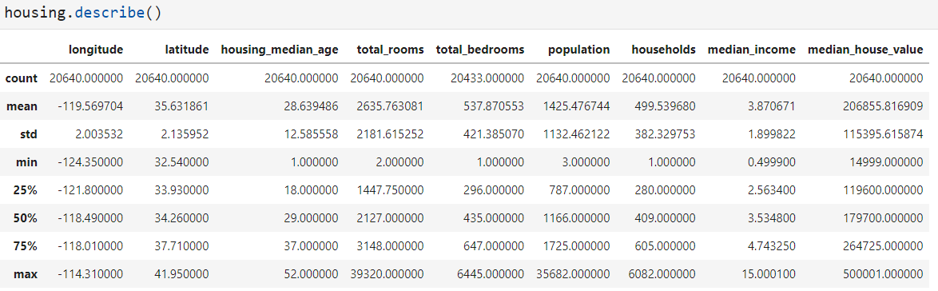
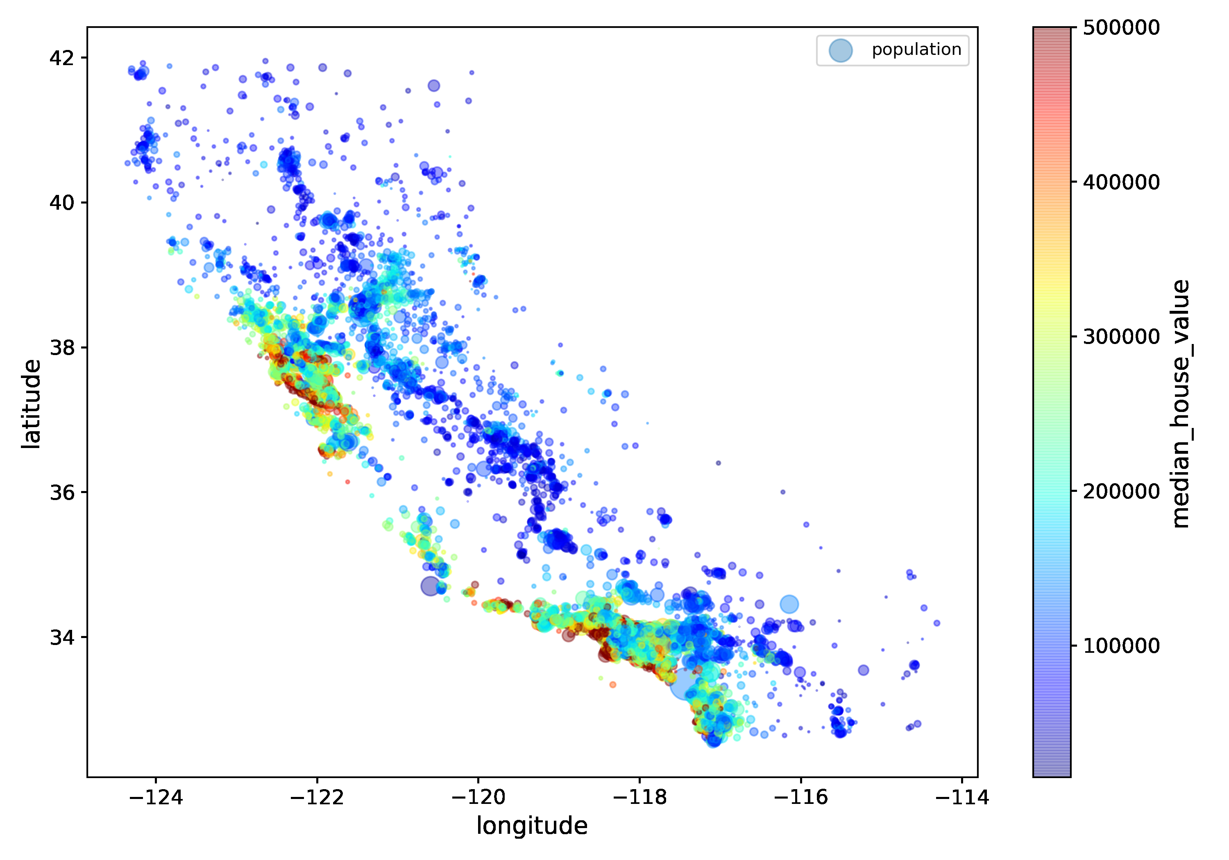
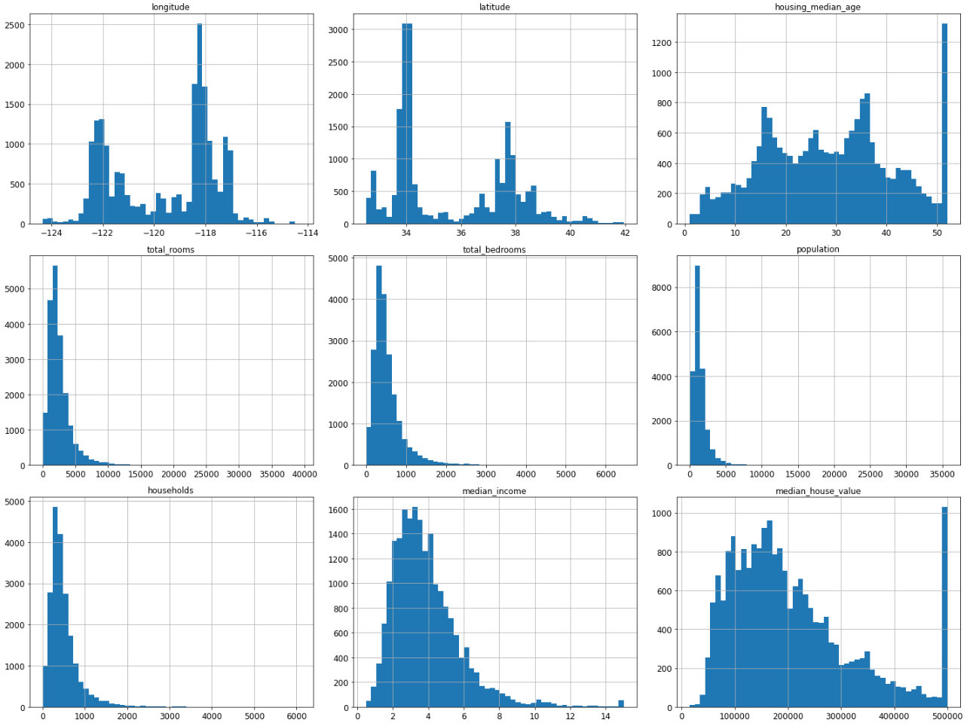
Dataset overview: California housing by district

Slide 6
Assignment Overview
Most of the code is provided (inspired from HOML chapter 2)
Assignment:
Small code activities that extend the code
Answering questions about the results
Note: Future homework will have less provided code
4 Activities
Acquiring info from, manipulating and subsetting data by criteria
Visualizing the data in meaningful ways
Exploring feature importance/relevance
Initial exposure to feature scaling options & results

